Slide 1

Welcome
Our Project Airawati Rural Municipality website

Slide 2
Rural Municipality website
Project Team Member
Ashim Khanal
Bikaram Acharaya
pashupati Raut
Nabin Shahi

Slide 3
Aim
Increases the efficiency and effectiveness of day-to-day operation.
Enhances decision support by integrating and streamlining access to asset solved data
Improves service to constituents despite limited human and budgetary resources
Look people various information of rural municipality

Slide 4
Introduction
increase the effectiveness and efficiency of many of the day to day operations required by rural municipality governments.
Each solved Module manages a special area of your business

Slide 5
Benefits
Gains the ability to query the map for fast, easy insight into an organization's assets.
Improves interdepartmental coordination and regulatory compliance initiatives.
Facilitates more efficient work processes by streamlining departmental communications, document management, and data maintenance.
Enjoys a single point of access to integrated data while coordinating relevant information directly with other departments.
Enhances output for both internal and external users by creating quality maps and preparing hundreds of standard reports quick and easy.

Slide 6
Feature
website applications are safe.
Website applications provide direct access to your data.
Data is backed up regularly and automatically.
You’re always using the latest and greatest version of the application. Work from anywhere, any time, any place.
website applications provide access to those who need it when they need it.
Website applications save money.

Slide 7
REQUIREMENT
FUNCTIONAL REQUIREMENT
NON FUNCTIONAL REQUIREMENT
USER REQUIREMENT
SYSTEM REQUIRMENT

Slide 8
SYSTEM REQUIREMENT
HARDWARE CONFIGURATION
SOFTWARE CONFIGURATION

Slide 9
SOFTWARE CONFIGURATION
Operating System (Linux, Windows, Mac)
Database Server : MY SQL, PHP
Language : HTML, CSS, JAVASCRIPT.
Compatible Browser : Microsoft Edge

Slide 10
HARDWARE CONFIGURATION
Ram: 4GB
Hard disk:1 TB
SSD: 256GB
Key board
Monitor: LCD
Processer :AMD Rayzen 5
Internet Connection

Slide 11
Functional requirement
User basic graphical tools such as shapes objects, brushes, color tools, eraser etc.
Should allow free hand drawing, object shapes such as
Circle, ellipse, rectangle, polygon.
Should allow the usage of different colors in the form of brushes, shapes, curves.
Manage the picture with tools such as pencil, airbrush etc.

Slide 12
Non-Functional Requirements
The system should be easy to use
The system should be available 24 hour
The system should response at the time
System should provide specifics information to specific user.
The system should be not fail
Right information is available to right people and staff at right time

Slide 13
Problem Definition
Decrease time to resolution
Time wastage
Avoid costly incidents
Increase productivity
Empower your team to find and learn from underlying causes
Increase customer satisfaction
Promote continuous service improvement
High cost
Manual work
Lake communication
Reputation problem

Slide 14
Charter statics of municipality website
Easy to access the data
Cost saving
Security
Simple
Fast speed
Easy to manage
Saleable and updateable

Slide 15
Purpose
The main purpose of our exercise is perform each employee’s activity in computerized way rather than manually which is time consuming
The entre activity is to automate the process of day to day activity of rural

Slide 16
Time period of general rural website
System testing after 1day
Choose language (HTML CSS JAVASCRIPT etc.)after 1 day
Basic coding after 8day
Add interface after 2 day
Customer interact features after 2day
Link database after 7day
Website testing after 5 day
Release after 3day
Complete website after 30 day

Slide 17
Saving cost rural municipality website
Hosting and security
Technical support and maintenance services
Internal staffing and resources
People access the information and data at home
Increase time and money for user

Slide 18

Er-Diagaram

Slide 19
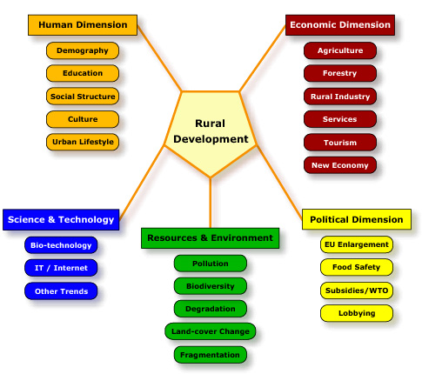

Slide 20

Snap chat

Slide 21
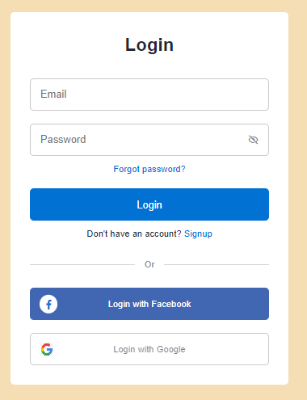
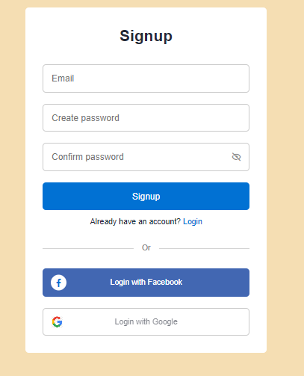
Interface Design

Slide 22

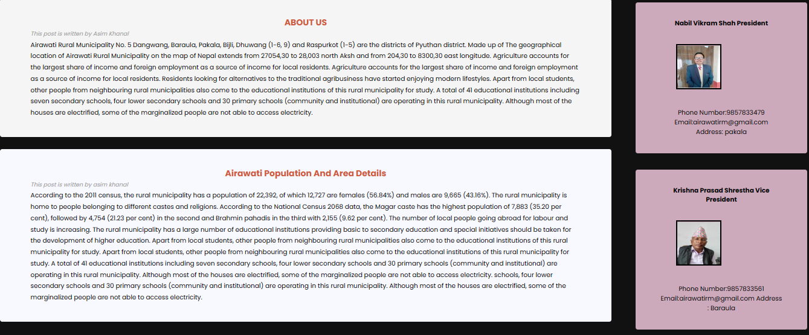
Interface Design

Slide 23
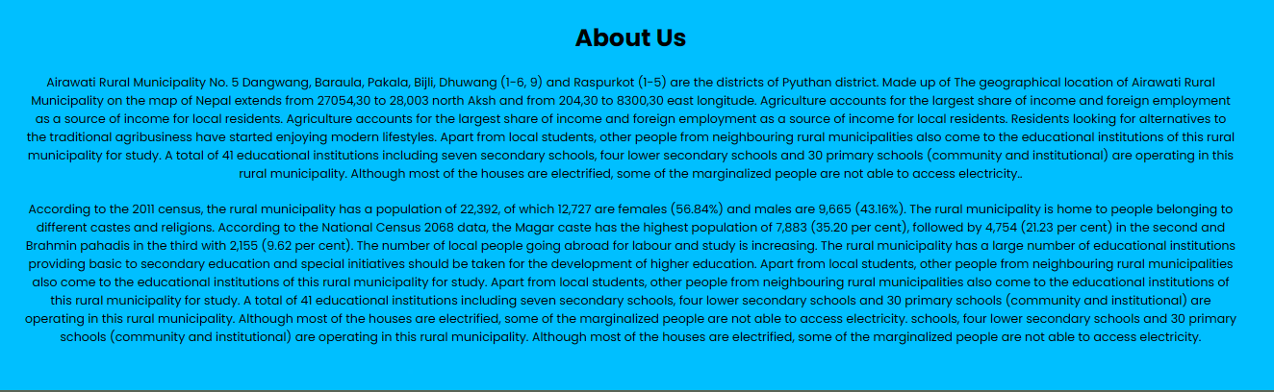
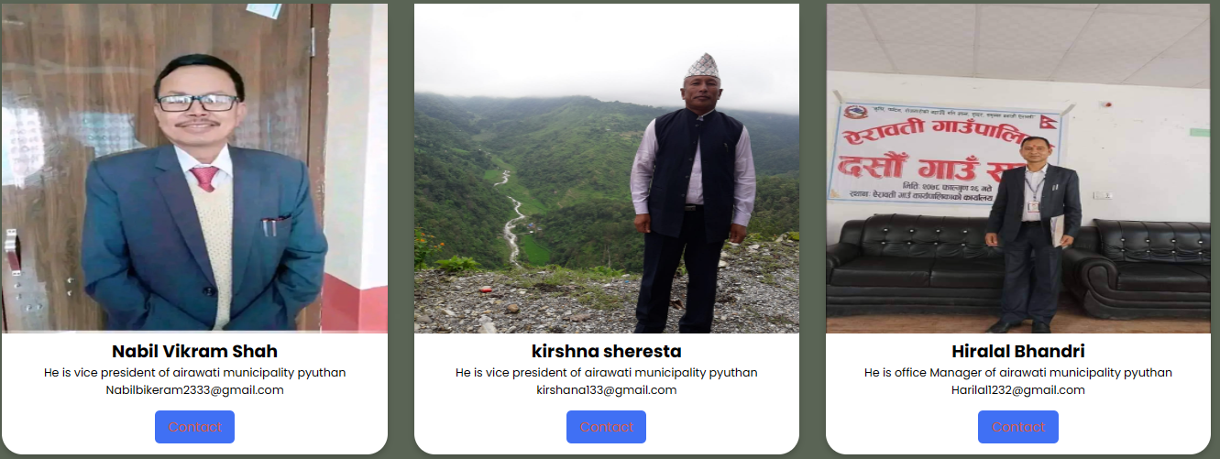
Interface design

Slide 24
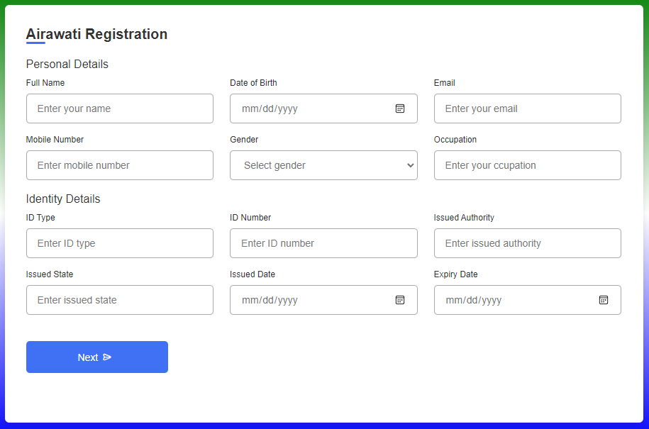
Registration

Slide 25
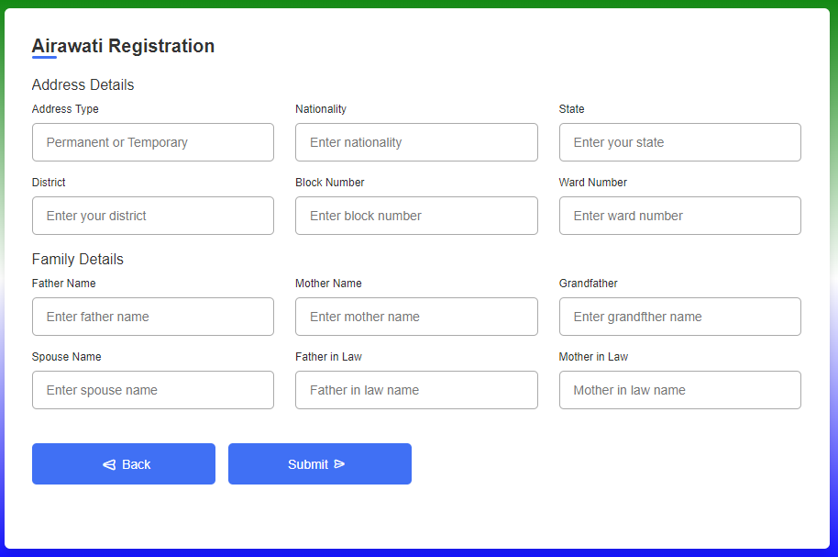
Registration form

Slide 26
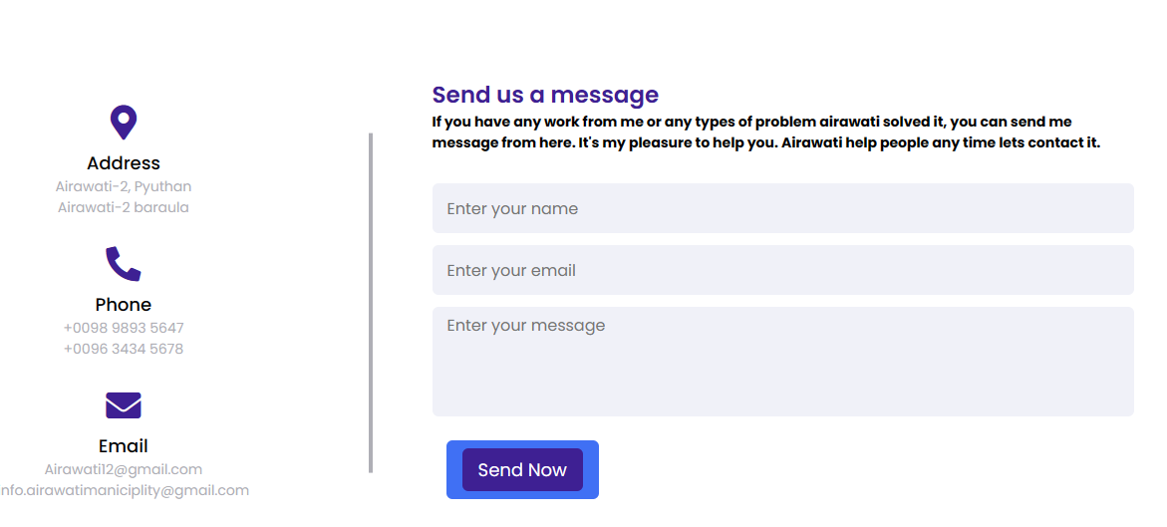
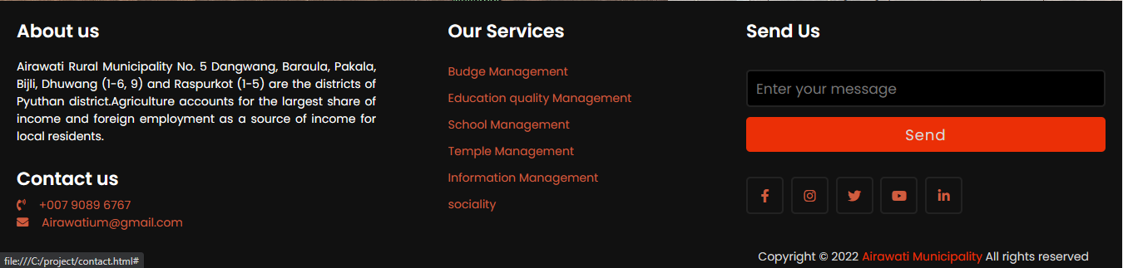
Interface design

Slide 27
Objective And Description
Track and assess known problems to keep teams organized and working on the most relevant and high-value problems.
The Core System provides overall system integration to all other Management Modules. Since these modules are so tightly integrated, the Core System modules are offered together as a package

Slide 28
Conclusion
This project is developed to nurture the need of user in a rural sector by embedding all the task of transactions taking place in Rural municipality
Future version of the website will still be much enhanced than different version. Thus rural municipality website it developed and executed successfully

Slide 29
Bibliography
Learning Sites:
https://www.w3schools.com/html/
https://www.codinglab.com
https://www.w3schools.com/php/default.asp
https://www.bootstrap.com/html/
https://www.codinglab.com

Slide 30
Thanks!!

